Slide 1
Retail Store Performance
Report By Vivek Pradhan

Slide 2
Insights
The total marketing spend is 45309 and Revenue is 493768.
Revenue generation is higher from Grocery as compared to Electronics and Clothing as seen in the Pie chart.
Higher the product variety higher the Sales, this can be drawn from the Scatter plot.
Customer footfall can be inferred as higher with higher Marketing expenditure which shows an extreme impact on Sacramento which is Marketing expense sensitive.
The Store locations with higher customer footfall with high marketing expense are Sacramento and Los Angeles.
The Store locations with higher customer footfall with low marketing expense are Los Angeles and low in Palo Alto.
High employee efficiency doesn’t lead to high revenue as we can see that higher employee efficiency contributing to sales between 150-300.
We can derive that the father the competitor higher the Marketing employed by retail stores. Competitors at a distance of 10-20 has higher marketing spend than 0-10.

Slide 3
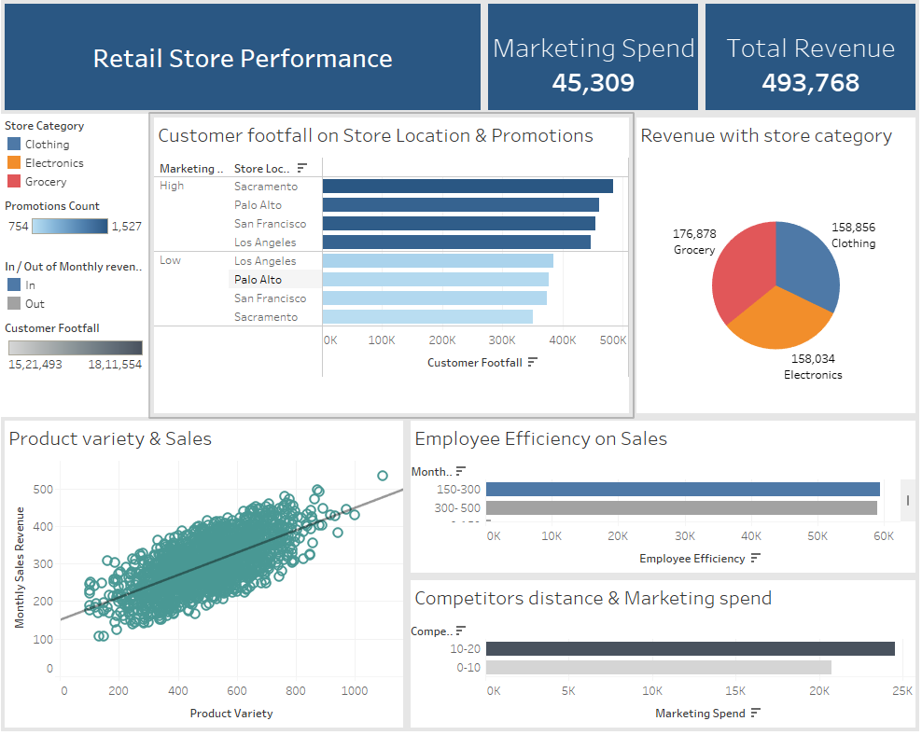
Dashboard

